Slide 1
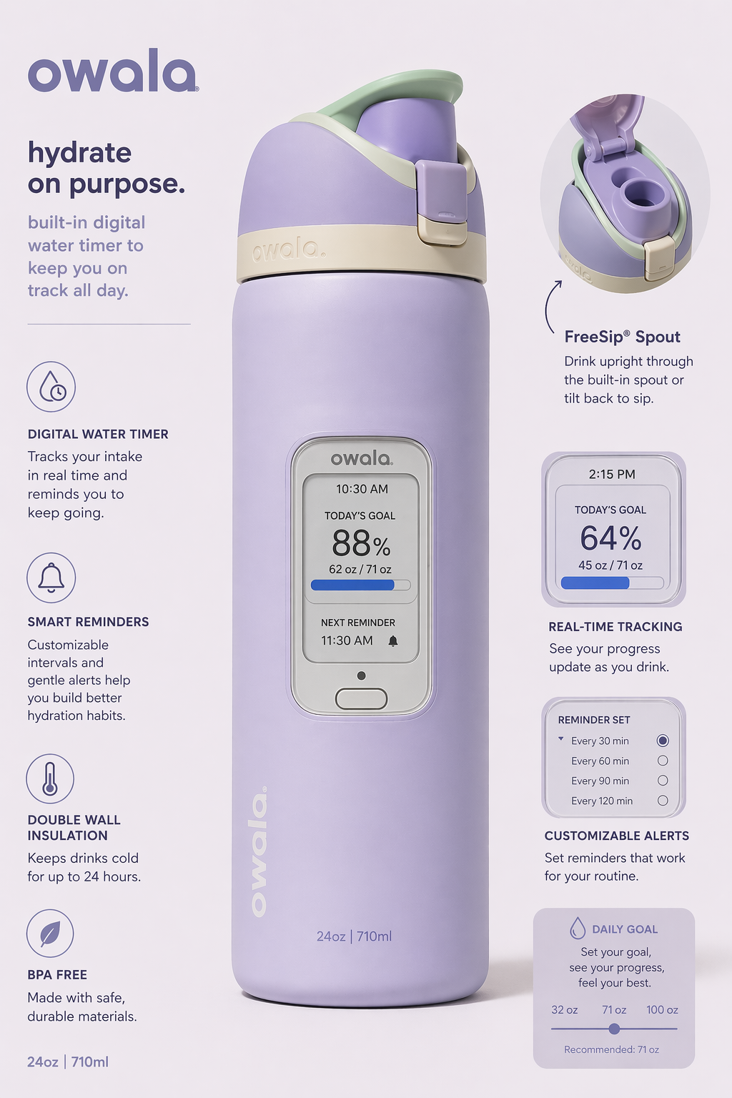
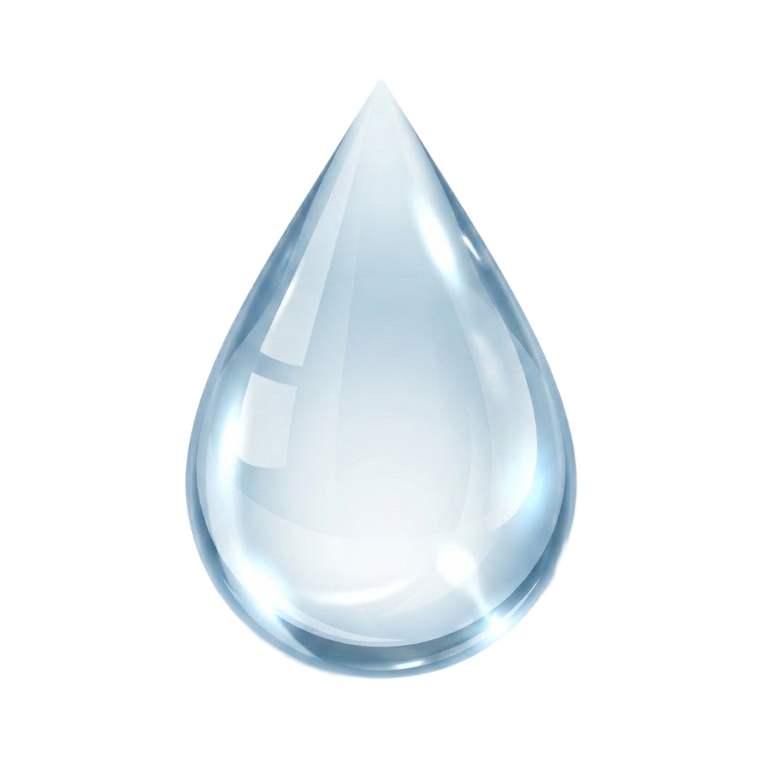
OWALA
WATER TIMER
Smart Hydration. Built Into Your Bottle.
Group Members: Anika Bandwar • Mehul Jain • Colin Kummings • Rosie Kwok • Victoria Kokoszka • Aditya Patel • Sahishnav Grende • Vishwajith Banala
Course: Intro to Marketing, Spring 2026, 04/23/26

Slide 2




Market Research Colin Kummings
Consumer Trends & Competitive Landscape
$2.8B
$8.9B
10.7%
Global Smart Water Bottle
Market (2025
Projected Global Smart Water Bottle Market by 2036
Compound Annual Growth Rate for the Global Smart Water Bottle Market
Market Trends and Target Customers
Competitor Landscape
Water bottle trends cycle every 2–3 years (Nalgene → HydroFlask → Stanley → Owala)(Driven by Social Media/Influencers)
Brand | Reminder | Tracker | Physical Timer
Owala (current) | ✗ | ✗ | ✗
HidrateSpark PRO 2 | ✓ App | ✓ App | ✗
LARQ PureVis 2 | ✗ | ✗ | ✗
Water Timer ✦ | ✓ Built-in | ✓ Built-in | ✓
Target Customers: Fitness enthusiasts, office and remote workers, Gen Z and millenials (18-25), healthcare and medical Users
Wellness/Fitness culture are driving demand along with sustainability pushing reusable drinkware
Physical product reminders outperform digital alerts in behavior change studies
North America = 39.6% market share and reminder feature usage is up 14% YoY
WATER TIMER | Owala Innovation Concept
2

Slide 3




SWOT Analysis Anika Bandwar
Strategic Assessment of Water Timer
STRENGTHS
OPPORTUNITIES
Established Owala brand equity and recognizable aesthetic
Product differentiation through built-in hydration reminder functionality
Greater convenience than app-based reminder alternatives
Blends form and function for a wellness-oriented consumer
Expansion of the health-conscious and wellness-focused consumer market
Increased popularity of products tied to habit formation and self-improvement
Ability to capitalize on evolving reusable bottle trends
External partnership and influencer marketing opportunities in fitness and wellness spaces
INTERNAL
EXTERNAL
WEAKNESSES
THREATS
Increased manufacturing and retail cost due to added technology
Potential maintenance concerns such as charging, durability, or technical failure
More complex product offering than Owala’s standard bottles
Uncertainty around long-term consumer adoption of the added feature
Competitive pressure from existing bottle brands and substitute products
Indirect competition from free digital hydration reminder tools
Risk of feature imitation if the concept gains popularity
Consumer resistance to a premium-priced bottle in a crowded market
WATER TIMER | Owala Innovation Concept
3
Notes:
Anika
“Here is the SWOT analysis for Water Timer. Starting with our INTERNAL strengths, in the current market we have Owala’s strong brand identity and recognizable design. We also benefit from product differentiation through the built-in hydration reminder functionality, which makes it more convenient than relying on separate apps and aligns well with wellness-focused consumers.
For our INTERNAL weaknesses, the added technology would increase manufacturing costs and make the product a more complex offering than Owala’s standard bottles. There are also possible concerns around the durability, charging, and whether consumers will consistently value the added feature long term.
Looking at EXTERNAL opportunities, Water Timer fits well with growing consumer interest in health, wellness, and habit-building products, and lets us dip more into those growing markets. It also creates room for partnerships with fitness and wellness influencers and allows Owala to build on the reusable bottle trend.
Finally, for EXTERNAL threats we have competition not only from other bottle brands, but also from free digital hydration reminder tools, and the risk of imitation if the idea becomes popular. There is also the challenge of convincing consumers to pay a premium price in a crowded market.”

Slide 4



Segmentation, Targeting & Positioning Aditya Patel
Who We Reach and How We Stand Out
SEGMENTATION
TARGET AUDIENCE
Age: 18–35 (Millennials & Gen Z)
"The Wellness Optimizer"
Lifestyle: Health-conscious, gym-goers, remote workers
Age 22–34, active lifestyle, sets daily health goals
Already owns a water bottle but wants smarter habits
Behavior: Frequent water bottle users, wellness app users
Frustrated by notification overload from hydration apps
Income: Mid to upper — $40K+ household
Willing to pay a premium for a clean, functional design
Values: Sustainability, self-improvement, routines
POSITIONING STATEMENT
"For health-conscious young adults who want to build better hydration habits, Water Timer is the only smart water bottle that delivers built-in reminders and daily tracking — no app required."
Why This Audience?
This segment has the purchasing power, brand awareness of Owala, and the unmet need that Water Timer directly solves: effortless hydration accountability, especially considering drinking enough water is essential to a good lifestyle.
WATER TIMER | Owala Innovation Concept
4

Slide 5




Marketing Mix—The 4 Ps Rosie Kwok
Product · Price · Place · Promotion
PRODUCT
PRICE
Owala-based bottle with side-mounted digital built-in water timer and water-motion sensor
Battery via USB-C charging port backed with solar power
BPA-free, free-sip technology, leak-proof lids, made to be sturdy & long-lasting
Must be handwash, not dishwasher safe; lid & straws are dishwasher safe
Available in 3 sizes: 24 oz, 32oz & 40oz
Multi-colored combination, compatible for males & females (unisex)
Retail price (standard price on the Owala site)
$45 (24 oz) $50 (32 oz.) $55 (40oz)
Prices are subject to change depending on varying locations & time of season
1-year warranty for technology damage/malfunctions through Owala site
PLACE
PROMOTION
Owala.com (Direct To Consumer)
Target, Walmart, Dick's Sporting Goods, Urban Outfitters, Tilly's, TJMaxx, Marshalls (retail)
Amazon, EBay, TikTok Shop (E-Commerce)
Campus book/merchandise stores
Planet fitness, Crunch Fitness, other fitness locations
Mall & shopping districts
Social media partnerships with fitness influencers or athletes
Ads & marketing directly through Owala’s social media accounts
Collaboration with athletic brands like Nike, Adidas, Under Armor, etc.
Back-to-school & black friday & cyber monday discounts
Student discounts applicable through Owala site
Seasonal & limited edition water bottle designs
Newsletter signups for exclusive deals
WATER TIMER | Owala Innovation Concept
5

Slide 6



Digital Marketing Strategy Vishwajith Banala
Multi-Channel Campaign Approach
Social Media
Content Marketing
Tiktok and Instagram reels targeting a younger audience
Partner with other fitness creators to show real use
Short content to show the functionality of the product
Blog posts (Ex: How hydration improves focus, energy, and gym performance)
Youtube/Tiktok demos showing how the product is used
Before v After hydration habit demonstrations
Infographics on hydration benefits
Email Marketing
SEO & Discovery
Welcome email: How to set up your hydration goals
Weekly hydration, fitness, or productivity tips
Reminder emails for inactive users
Discount emails for students
Target keywords (“smart water bottle”, “hydration tracker”, “how to drink more water”)
Use Tiktok hashtags for discovery
Reddit and fitness forums for discussion
WATER TIMER | Owala Innovation Concept
6

Slide 7
Implementation Plan Victoria Kokoszka
Key Milestones & Responsible Parties
Months 1–3
Months 4–6
Month 7
Months 8–12
Phase 1
Phase 2
Phase 3
Phase 4
Research & Development
Pre-Launch & Marketing Prep
Official Launch
Growth & Optimization
Study products that have similar features (FitBit, LARQ) and other water bottle brands and their new features (HydroFlask, Stanley)
Consult with developers to find the logistics of the product and create blueprints
Conduct studies among current Owala customers by offering discounts as incentives
Research the water bottle market for the profitability of creating this product.
Gain a control group of customers and have them use the new cap for 2 weeks - a month, and review the findings
Research each niche marketing that this cap would fall into and decide (health buffs, new moms, everyday active individuals)
Connect with influencers and other online figures to find an advertising partnership
Promote via all media mentioned previously
Launch on the Owala website + Target/do in store giveaways
Pay for further advertising on search engines, social media, and streaming platforms
Reach out for a potential celebrity sponsorship
Review market data + purchasing data of product and see if either price or product needs to be revised
Understand the top consumer of the product, whether the same or different, and curate further towards them if new, and slightly branch out if the same.
Introduce new features of the product/create promo discounts depending on success
Responsible Parties: Marketing Team • Product Design • Sales & Distribution • Digital/Social Media • Data Analysts
WATER TIMER | Owala Innovation Concept
7

Slide 8
Budget Overview Sahishnav Grende
Estimated First-Year Launch Investment
Budget Breakdown
Product Development & R&D
$120K (30%)
Manufacturing & Tooling
$80K (20%)
Marketing & Advertising
$80K (20%)
Influencer & PR Outreach
$40K (10%)
Distribution & Retail Setup
$40K (10%)
Market Research & Testing
$20K (5%)
Contingency / Misc.
$20K (5%)
TOTAL LAUNCH BUDGET: $400,000 | Estimated First-Year ROI Target: 2.5x
WATER TIMER | Owala Innovation Concept
8

Slide 9
Evaluation & Metrics Mehul Jain
How We Measure Success
1. Sales & Growth KPIs
2. Customer Usage KPIs
3. Customer Satisfaction KPIs
Units Sold
Daily Active Users (DAU)
Customer Satisfaction Score (CSAT)
number of bottles sold per month
how many people use the timer feature daily
rating from surveys (1–5 or 1–10)
Revenue Growth Rate
Avg. Daily Water Intake Tracked
Net Promoter Score (NPS)
% increase in sales over time
measures if users actually drink more water
how likely users are to recommend it
Market Penetration
Feature Engagement Rate
Return/Refund Rate
% of target market (students, gym users, etc.) using the product
% of users actively using the timer/reminder
% of customers returning the product
4. Retention & Loyalty KPIs
5. Brand & Marketing KPIs
6. Health Impact KPI
Repeat Purchase Rate
Social Media Engagement
Hydration Improvement Rate
customers buying again (gifts, upgrades, etc.)
likes, shares, comments on posts
% increase in users meeting daily water goals
Customer Retention Rate
Conversion Rate
% of users still using the bottle after 30/60/90 days
% of people who see the product and actually buy it
Customer Acquisition Cost (CAC)
cost to gain one customer
WATER TIMER | Owala Innovation Concept
9

Slide 10
The Future of Hydration
Is On The
Bottle.
Water Timer: Smart Hydration by Owala
Thank you! We're happy to answer any questions.
WATER TIMER | Owala Innovation Concept
10

